Slide 1

“E COMMERCE”
Task - 2

Slide 2
FOOD DELIVERY WEBSITE
Welcome to our food delivery website! We are delighted to offer you a convenient and reliable way to enjoy your favorite food from the comfort of your own home.
LMS Username | Name | Batch
2113a54251 | PARUCHURI PAVAN | A54
2113a54289 | VISHNU VARDHAN D | A54
2113a54291 | YUVAN SAI P S | A54
2113a54260 | ROUSHITH M | A54
2113a54281 | SAI SUSHANTH T | A54

Slide 3
Task - 2
Create various Front End Programs
Draw and design a uniform front end code for calculaor
<!DOCTYPE html> <html> <head> <meta name=“viewport” content=“width=device-width, initial-scale=1.0”> <title>Calculator using javascript – Easy Tutorials</title> <link rel=“stylesheet” href=“style.css”> </head> <body> <div class=“container”> <div class=“calculator”> <form> <div class =“display”> <input type=“text” name=“display”> </div> <div> <input type=“button” value=“AC” onclick=“display.value = ‘ ‘ “ class= “operator”> <input type=“button” value=“DE” onclick=“display.value = display.value.toString().slice(0,-1)” class= “operator”> <input type=“button” value=“.” onclick=“display.value += ‘.’ “ class= “operator”>

Slide 4
<input type=“button” value=“/” onclick=“display.value += ‘/’ “ class= “operator”></div>
<div>
<input type=“button” value=“7” onclick=“display.value += ‘7’ “ >
<input type=“button” value=“8” onclick=“display.value += ‘8’ “>
<input type=“button” value=“9” onclick=“display.value += ‘9’ “>
<input type=“button” value=“” onclick=“display.value += ‘’ “ class= “operator”></div>
<div>
<input type=“button” value=“4” onclick=“display.value += ‘4’ “>
<input type=“button” value=“5” onclick=“display.value += ‘5’ “>
<input type=“button” value=“6” onclick=“display.value += ‘6’ “>
<input type=“button” value=“-” onclick=“display.value += ‘-’ “ class= “operator”></div>
<div>
<input type=“button” value=“1” onclick=“display.value += ‘1’ “>
<input type=“button” value=“2” onclick=“display.value += ‘2’ “>
<input type=“button” value=“3” onclick=“display.value += ‘3’ “>
<input type=“button” value=“+” onclick=“display.value += ‘+’ “ class= “operator”></div>
<div>
<input type=“button” value=“00” onclick=“display.value += ‘00’ “>
<input type=“button” value=“0” onclick=“display.value += ‘0’ “>
<input type="button" value="=" onclick="display.value = eval(display.value)" class="equal operator"></div>
</form></div></div>
</boby>
</html>

Slide 5
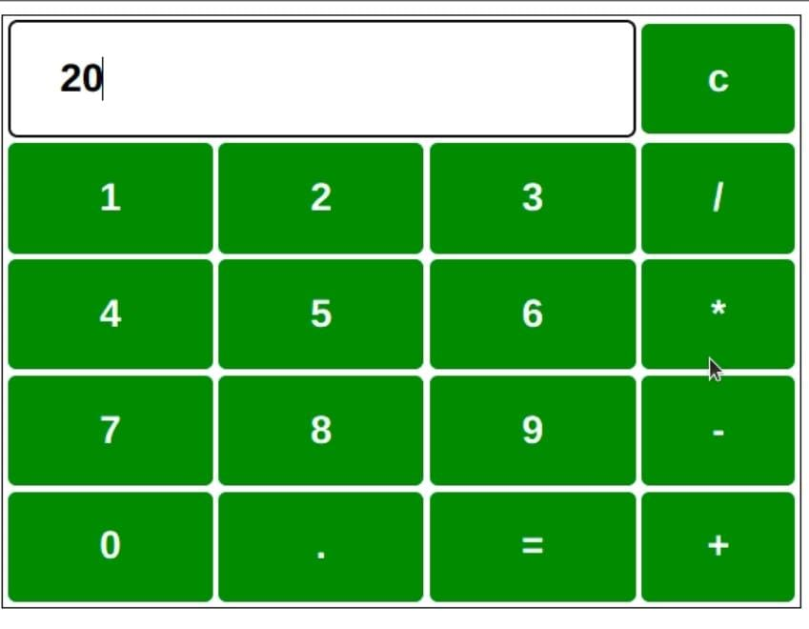
Evaluation Metric:
100% Completion of the above tasks
Learning Outcome
Get to know about concepts of project bucketing
Knowing about various frontend development framework like angular, vue,react
Know about various react topics like components, props, state, life cycle etc.

Slide 6
Step-Wise Description
HTML structure
Style sheet
Calculator container
Display area
Number buttons
Operator buttons
Clear button
Equals button
JavaScript code
Summary of your task
HTML calculator is used for performing basic mathematical operations like Addition, subtraction, multiplication, and division.To design the basic calculator, we will use HTML, CSS, and JavaScript. HTML is used to design the basic structure of the calculator. CSS styles are used to apply styles on the calculator and JavaScript is used to add the calculation functionality.

Slide 7
Assessment Parameter
Setup Project for Calculator project
Setup basic structure of text-editor project
Create a main component with the outer structure of calculator
Check-List
Create main component with all feature buttons
Create a button component with on click handler
Create a json object to store data for text editor
Create a ` evaluateExpresion` function to evaluate value
Push both code to github

Slide 8
Submission Github
https://github.com/saisushanth-90

